Slide 1
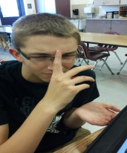
Bureau of Biometric Devices
Mahreeee
Nahkheetah
Jeahzmeen
Behn

Slide 2
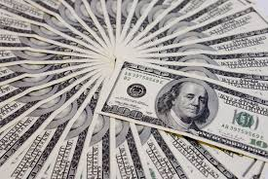
Name and Mission Statement
B.B.D.- Bureau of Biometric Devices
We pledge to keep YOUR secrets YOURS.
$411,830 per facility with a $500 installation fee
Prevent further leaks of government confidentiality by:
Making places harder to access
Preventing agents from falsely accessing information

Slide 3
Proposed Security Plan
Replace or Supplement all security measures in place all government facilities to protect secrets (don’t ask where because that’s classified)
Expect the worse case scenario.
Place all agents and verified personnel's fingerprints and DNA under a code green data base
One device attached to the wall, but another has the ability to wirelessly sync to computer information
Has a test for whether or not something is blood

Slide 4
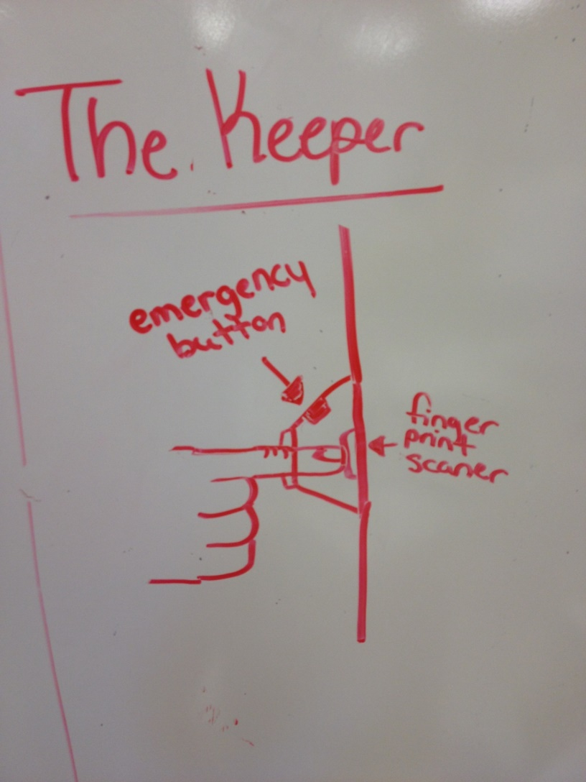
Picture of Product

Slide 5
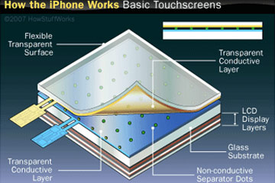
Science behind Methods
Capacitive touch screens
Use a layer of capacitive material holds an electrical charge
touching the screen changes the charge at a specific point of contact.

Slide 6
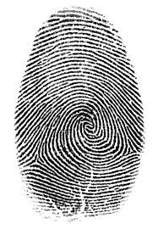
Science behind Methods
Every person has one of three different types of fingerprints:
Loops: ulnar, radial
Whorls: douple loop, central pocket, accidental
Arches: plain, tented
Also, each person has different minutiae points (ex:deltas, bridges, eyes, specialties, hooks, etc.)

Slide 7
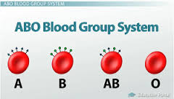
Science Behind Methods
Field within machine contain antibodies which provoke different reactions with antigens within your red blood cells
Machine can determine blood quickly and effectively

Slide 8
Success Story
Do ya’ll remember that atomic bomb last year?
XXXXXXXX
Agent was held at gun point and pushed the button, code was not received, and security was alerted
EXACTLY.

Slide 9
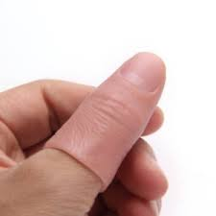
Can it be Beaten?
Uses the same technology as a touchscreen phone to make sure that no finger substitutes are being used
All people (including identical twins) have different fingerprint variations
Pricks finger to check for blood

