Slide 1
Respiratory System
By Ben Duncan, Chelsea Sams, Marie McClary, and Shelby Wathen

Slide 2
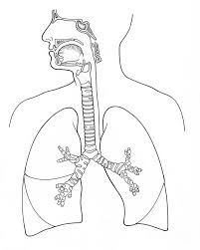
Function of the Respiratory System
The respiratory system takes in oxygen and brings it into the lungs.

Slide 3
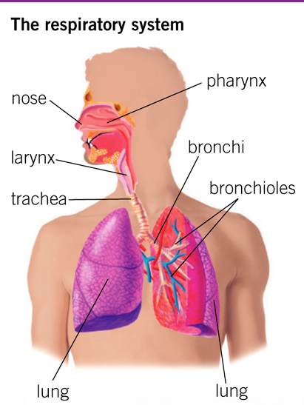
Organs of the Respiratory System
Lungs
Bronchi
Bronchioles
Trachea (windpipe)
Larynx (voice box)
Pharynx (throat)
Nose

Slide 4
FIVE AMAZING FACTS
Your hairs in your nose help clean the air and warm it as well.
The surface area of your lungs is approximately the same size of a tennis court.
Some people can hold their breath for more than 20 minutes, such as free divers.
Asthma was once treated with psychotherapy during the 1930s-1950s.
The reason you yawn is because your brain tells your lungs that your oxygen is too low and that you need to take in large amounts of oxygen.

Slide 5
Nervous System
Also by Ben Duncan, Chelsea Sams, Marie McClary, and Shelby Wathen

Slide 6
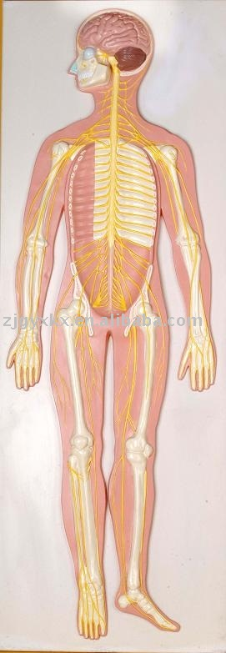
Function of the Nervous System
The nervous system is the primary control system of the body.

Slide 7
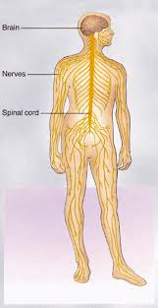
Organs of the Nervous System
Brain
Spinal chord
Nerves
Sensory organs
Eyes, ears, nose, tongue, skin

Slide 8
FIVE AMAZING FACTS
There are more nerve cells in the human brain than stars in the Milky Way Galaxy.
If you lined up all the neurons in your body, the length would equal 600 miles.
There are 13.5 million neurons in the human spinal cord.
As we get older, the brain loses about a gram per year.
Electrical signals travel in nerve fibers at about 280 km/h or faster.

Slide 9
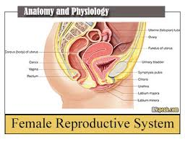
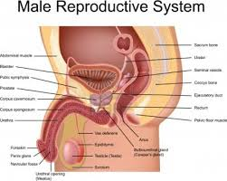
Reproductive System Fact
Some women can be born with 2 uteruses. There was a woman who gave birth to two healthy twins that developed separately in their own womb.

