Slide 1
Patient #6: Susan
Ben, Jacob, Jenna, & Nikita

Slide 2
Susan’s Story
Susan, a 35 year-old teacher, has been referred to you from a psychologist who works in your building. She was being treated for depression and mild mood swings, but now that she has started having physical symptoms, the psychologist thinks she needs a neurology consult. Obviously nervous, Susan says, “You might think I am crazy, but sometimes my hands and feet just seem to move on their own, kind of like they are dancing.” She goes on to say that she remembers her mother experiencing the same thing a few weeks before she died. Sadly, her mother was killed in a car crash before the doctors could ever explore her symptoms. Other than the limb movement, Susan has noticed that she seems to be forgetting little details at work. She has a few bruises on her legs. When asked about them, she tells you that she has been a bit clumsy lately and seems to fall down more than she used to.

Slide 3
Symptoms
Depression
Mild mood swings
Short term memory loss
Twitching of hands and feet
Clumsiness
Based on these symptoms, we concluded…

Slide 4
Huntington’s Disease

Slide 5
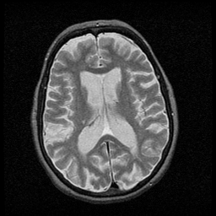
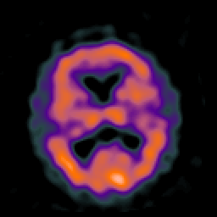
How Does It Happen?
An inherited degenerative brain disorder
A genetic disease caused by a mutation on the fourth chromosome
Is affected by the dominant allele
Its homozygous counterpart is no worse than the heterozygous form (truly dominant)
Patients may lose control of their extremities and start an erratic dance
No cure is known and most will be unable to care for themselves by 60

Slide 6
How Will Her Life Be
Live for 10-20 years
Change in behavior
New diet
Hard to keep still
Increased fatigue
Need for daily routine
Trouble thinking clearly

Slide 7
Genetic Counselor
Have a Masters of Science degree in genetic counseling
Provide information and emotional support
Offer counseling to promote informed choices
Help families and patients understand the genetics of special diseases

Slide 8
Neurologist
Principal care giver to patients with a neurological disorder
Diagnose and treat a neurologist disorder and advise primary care physician the patients overall health
Can help consult a patient on what exactly HD is and how best it can be managed
Can supervise any patients that may have required surgery
Available for information and consultation
Will provide care to patients that may require more frequent treatments

