Slide 1
Effect of Temperature on Catalase Activity Rate
Chelsea Sams, Abbie Stallings, Ben Duncan, Leslie Probus, and Cassie Blandford

Slide 2
Research
Research that has been done on this has shown that the heat from the heated hydrogen peroxide creates more kinetic energy, making the enzymes move faster in the solution so they collide with more substrates, creating a faster reaction. The opposite is present with the cold water, slowing the enzymes, so they collide at a slower rate. The room temperature would act as a control to see how everything would compare versus normal conditions.

Slide 3
Hypothesis
Our hypothesis is if the temperature is higher, the rate of the reaction would be faster, and if the temperature is lower, the rate of the reaction will be slower than the room temperature, or control.

Slide 4
Materials
Computer with Internet access and Vernier LoggerPro® software
LabQuest Mini
Vernier Gas Pressure Sensor
Laboratory journal
PLTW Biomedical Sciences Experimental Design handout
How to Write a Scientific Laboratory Research Report handout
Science Laboratory Report rubric
Catalase solution, 200units/mL
50mL graduated cylinder
Distilled water
125 mL Erlenmeyer flask
Magnetic stirrer
Stirring bar
1.5% H₂O₂ solution
Ring stand
Utility clamp
Thermometer (optional)
Two-hole rubber stopper assembly (provided with gas pressure sensor)
Tubing with Luer-lock connectors (provided with gas pressure sensor)
20-200 µL micropippetor (or transfer pipettes)
200 µL micropipette tips
Catalase and H₂O₂ solutions at varying concentrations/pH (optional)
Hot Plate
Ice Bath

Slide 5
Steps to the Procedure
Measure out 50mL of 1.5% H₂O₂ into a 125 mL Erlenmeyer flask.
Carefully place a stir bar in the flask.
Place a magnetic stirrer on the base of a ring stand. Use a clamp to fasten the flask to the ring stand as shown. Position the flask at the center of the magnetic stirrer.
Use the speed 125 rpm.
Stop the stirrer.
Use the plastic tubing with two Luer-lock connectors to connect the two-hole rubber stopper assembly to the Gas Pressure Sensor. About one-half turn of the fittings will secure the tubing tightly. The valve connected to the stopper should stay closed during this investigation.
Using a micropipette, add 100 µL of enzyme suspension to the contents of the flask.
Tightly seal the flask by twisting in the two-hole stopper connected to the Gas Pressure Sensor.
Ensure that the flask is properly positioned. Turn the stirrer on to the predetermined setting.
Start data collection.
Stop data collection after 200 seconds.
Repeat the other steps with the cold temperature except that when you measure out 50mL of H202 set it in the ice bath until it reaches the temperature 6°C. Then do the rest of the steps as normal
Repeat the other steps with the hot temperature except that when you measure out 50ML of H202 set it on the hot plate until it reaches 80°C. Then do the rest of the steps as normal.

Slide 6
Variables
Independent variable
Water temperature: hot, cold
Dependent variable
The rate of the reaction
Control
Room temperature

Slide 7
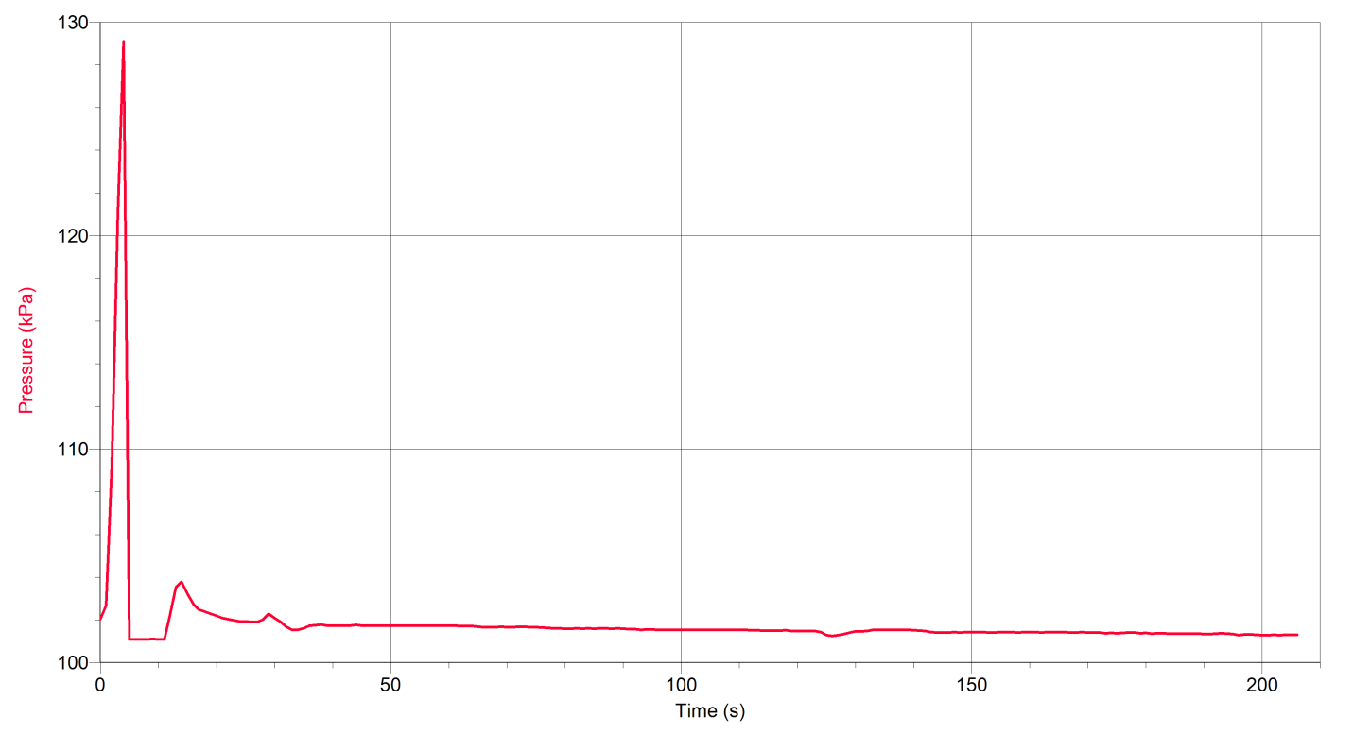
Room Temperature

Slide 8
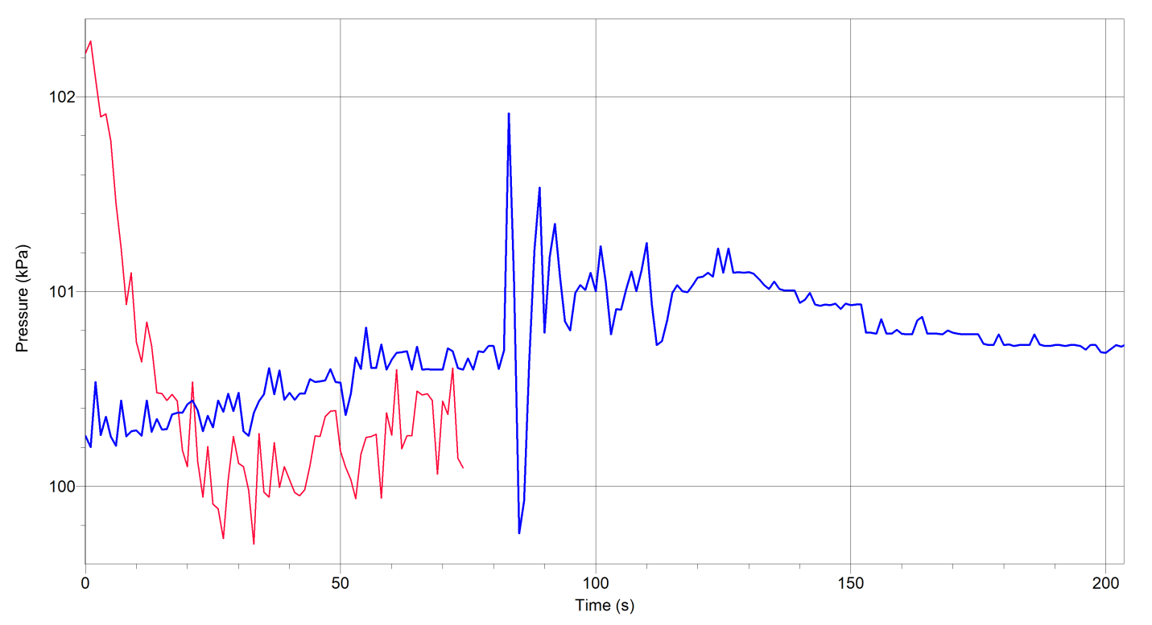
Hot Water

Slide 9
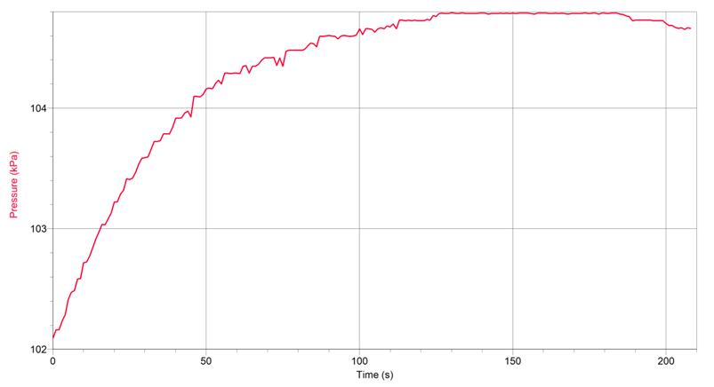
Cold Water

Slide 10
Overall Results
In this experiment, our hypothesis was found false because it showed that the rate of reaction was faster at room temperature. However, our results were inaccurate in the hot water experiment because the stopper had a leak and to move the reaction along we had to turn up the rpm to 700 instead of 125. The highest rate of reaction found in this experiment was found in the room temperature experiment.

