Slide 1
1st Degree Burns
By: Abbie Stallings, Autumn Coomes, Ben Duncan, Cassie Blandford, Chelsea Sams

Slide 2
Our Client
This is a 15 year old male that presented to our office of dermatology a first degree burn.
Ibraheem had lit his candles, dimmed the lights, and turned on his favorite Drake album. He drawn a luxurious bubble bath of lavender scented bubbles. Ibraheem jumped in the bath prepared for a relaxing evening but was instead burned by the scalding water.

Slide 3
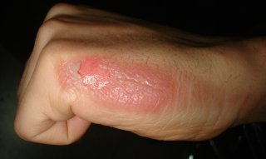
Our Client
He had received a first degree burn on the bottom half of his body.
Overall health
Can lead to an infection

Slide 4
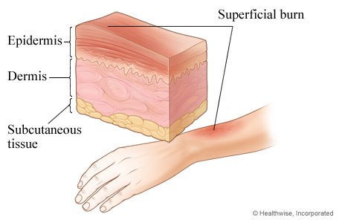
First Degree Burns
Affects only the epidermis (first layer of skin)
Doesn’t require medical treatment unless the burn is quite large
Symptoms
Redness
Dry skin
Painful to touch
Peeling skin

Slide 5
Other Body Systems
Nervous system
Nerves sends signals to brain to make you feel pain
Cardiovascular
The blood is drawn to your skin to give the red color
Fluids leak from blood vessels causing swelling

Slide 6
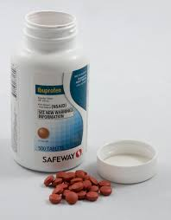
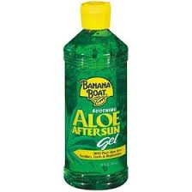
Treatment
Cold water
Acetaminophen or ibuprofen
Aloe
Moisturizer
Time is the best cure

Slide 7
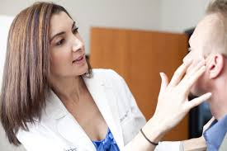
Biomedical Professionals
Dermatologist may prescribe a cream
Advise you to check your water temperature before you get in
Talks about protection and precaution

